Slide 1
Flappy Bird AI with
Genetic Algorithm
RUI CHENG

Slide 2
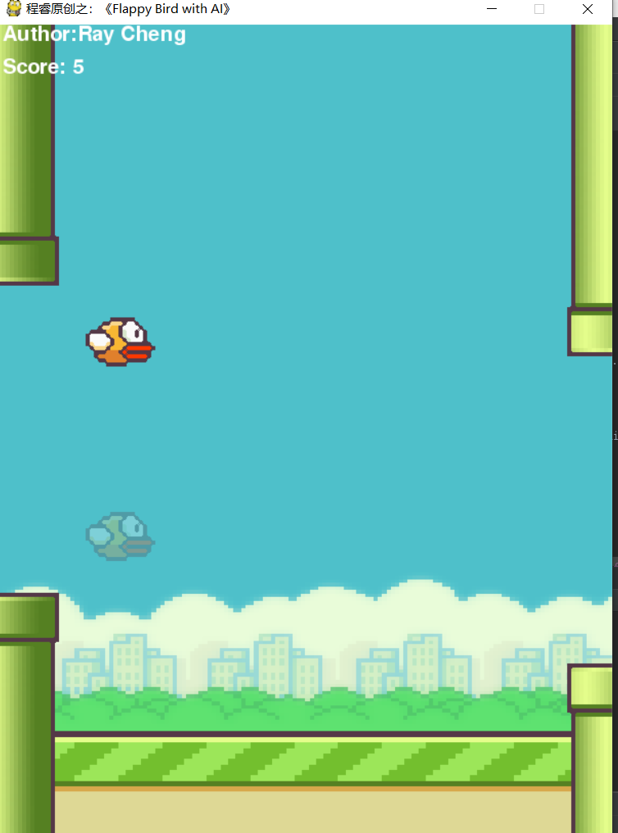
Project objectives
Train an AI that can play Flappy Bird.
Make it more powerful than most human players.
The right picture shows the Human-AI combat.
The transparent bird is controlled by AI
The opaque bird is controlled by player

Slide 3
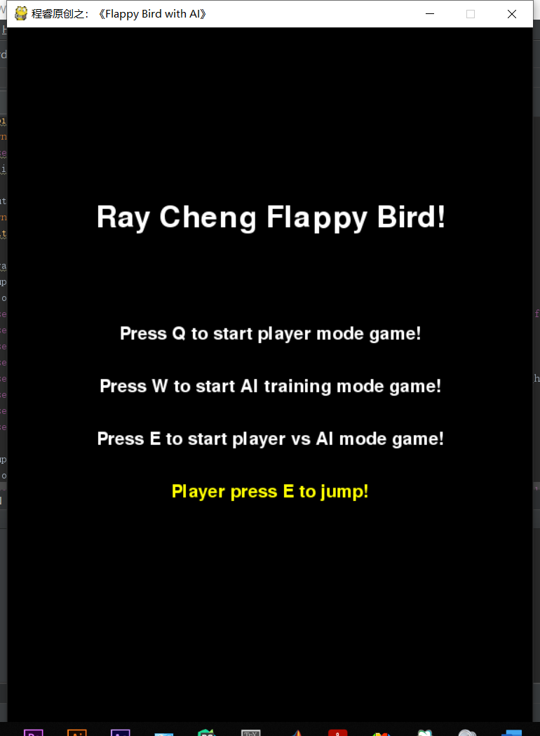
Hot Key Explain
Q: Single player mode, basic flappy bird game.
W: AI training mode.
E: Player vs AI mode. If the model hasn’t been trained, AI will use a random model which should be pretty easy to be defeated.
Jump: Player press E to jump.

Slide 4
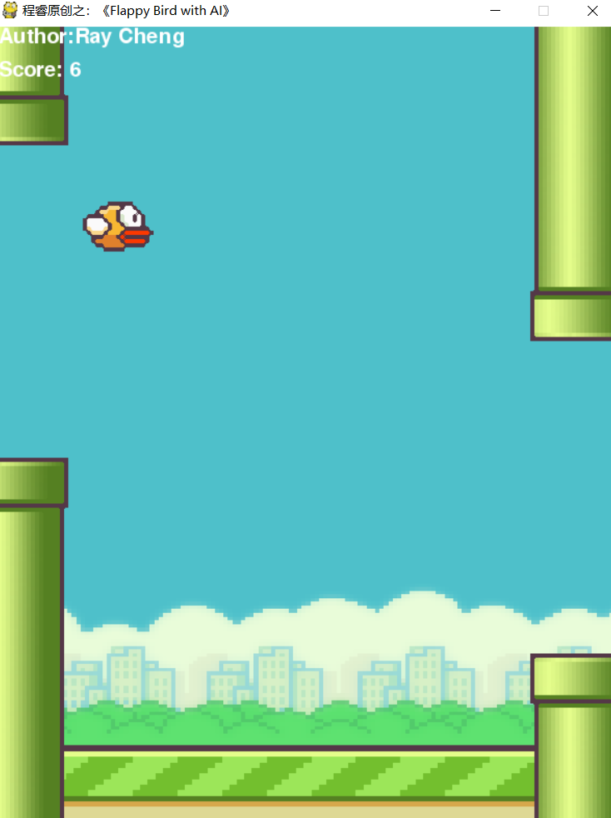
AI will based on basic flappy bird game.
Based on the PyGame package. We can build up our own FlappyBird game.
However, after that, how to make it more funny? For example: make an AI which can play with players?

Slide 5
How to build AI?
Flappy bird is a simple game.
AI only needs to judge when to let the bird jump up?
In order to make a decision to jump or not to jump, AI must be able to sense some key values from the environment and make a decision based on them.
So what key values can be used in the game?

Slide 6
Key Values
Self.y : bird Hight from the ground.
Self.vel : bird speed.
Top_pipe.x - Self.x : Horizontal distance from pipe to bird
Self.rect.centery – top_pipe.rect.centery : Vertical distance from top pipe to bird
Self.rect.centery – bot_pipe.rect.centery : Vertical distance from bot pipe to bird

Slide 7
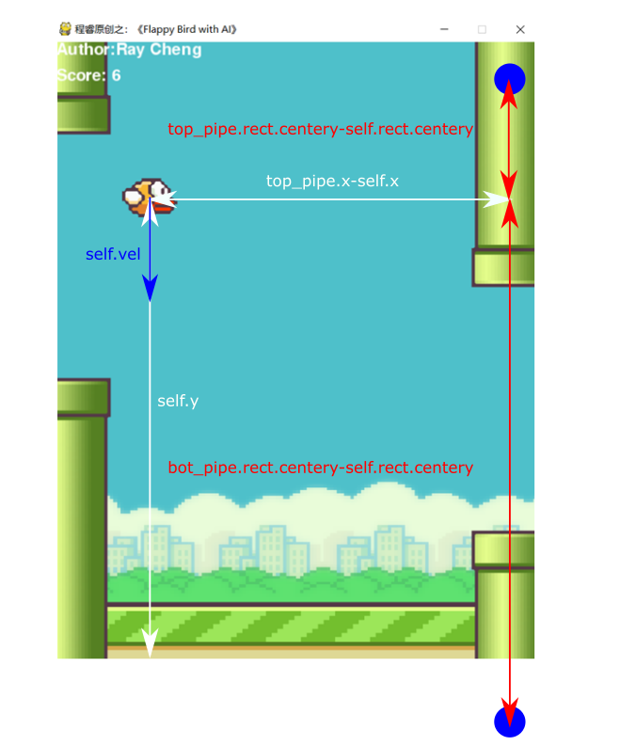
Key Values
Self.y : bird Hight from the ground.
Self.vel : bird speed.
Top_pipe.x - Self.x : Horizontal distance from pipe to bird
Self.rect.centery – top_pipe.rect.centery : Vertical distance from top pipe to bird
Self.rect.centery – bot_pipe.rect.centery : Vertical distance from bot pipe to bird

Slide 8
How to make decision based on key values?
3-layer Neural Network
Known theory: 3-layer neural network can fit all decision surfaces
Our NN: 4 inputs, 10 hidden units, and 1 output. The activation function uses sigmoid
In our network, self. y is not used as input data. Because in the test process, it is found that after using self. y as input, AI will try to pass through the pipelines by maintaining the bird height at an average value. However, this strategy can not make AI get more scores than human beings, and it seriously affects the training direction of AI. Therefore, I deleted this input and used only four input values.

Slide 9
Normalized Key Values First
Self.vel /10
(Top_pipe.x - Self.x)/PIPE_INTERVAL
(Self.rect.centery – top_pipe.rect.centery)/SCREEN_HEIGHT
(Self.rect.centery – bot_pipe.rect.centery )/SCREEN_HEIGHT

Slide 10
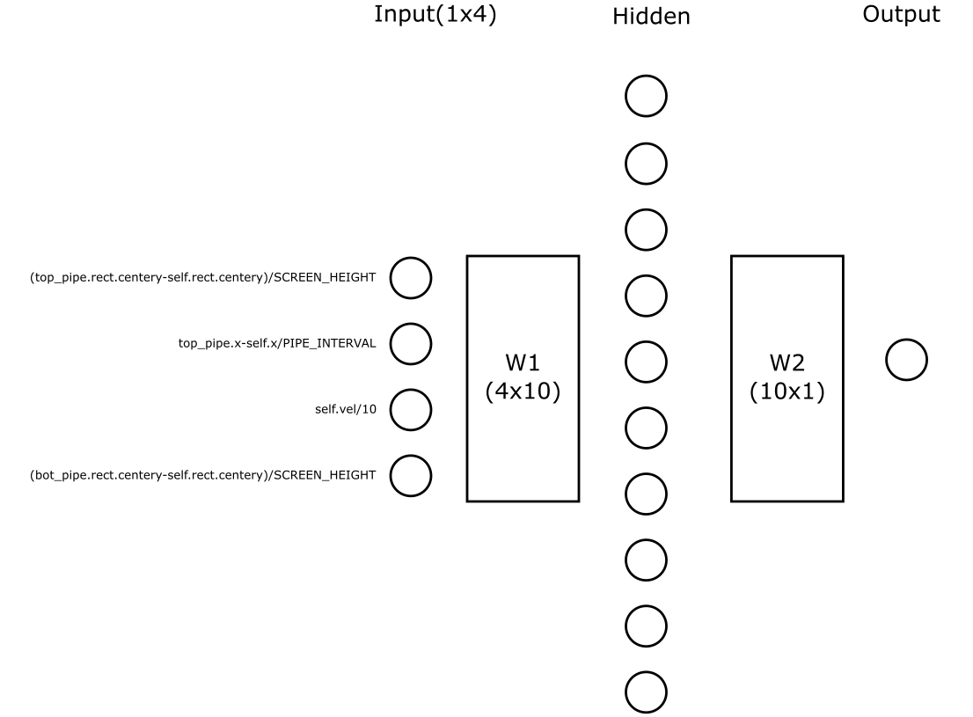
NN structure
Formula to get final out put
Z_hidden=Sigmoid(np.dot(input,W1))
Final_output=Sigmoid(np.dot(Z_hidden,W2))
Initialize W1 W2
All parameters random from [-1 1]
Jump Decision
If Final_output>0.5:
    Self.jump()

Slide 11
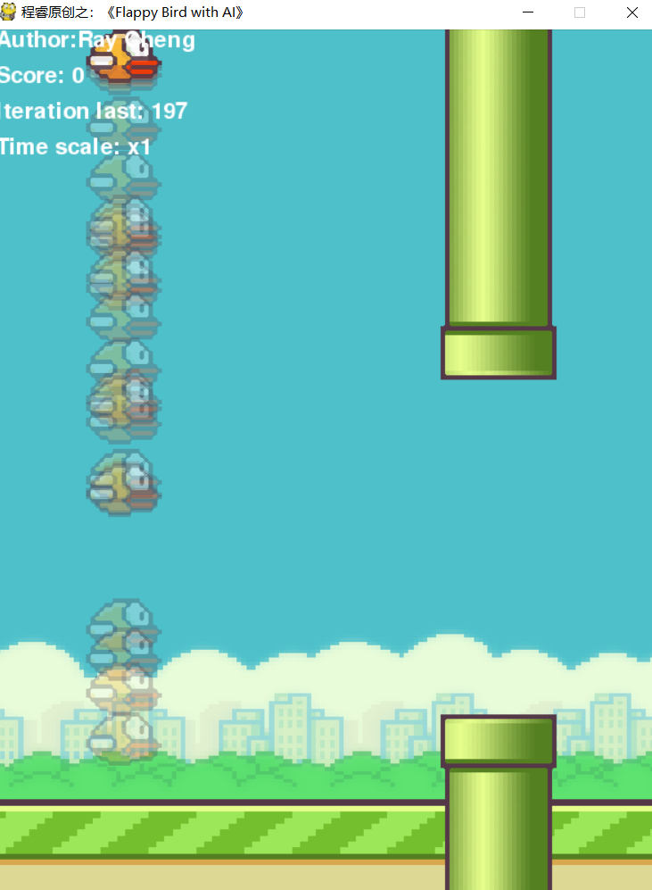
How to train AI?
Training rules:
1, Iteration time upper limit=200
2, 50 AI_birds for each iteration.
3, First initialize W1 W2 for all AI_birds. Each AI_birds have their own parameters.
4, According to the order of death, record AI_birds parameters in model_list
5, if any AI_bird passes 70 pipes, save its parameters.
6, if all AI_birds dead in 200th iteration. Save last survived AI_birds parameters.

Slide 12
How to update parameters?
King: model_list[-1] # last survivor
Queens: model_list[-5:-1] #Other 4 best survivors
They will have 50 babies for next iteration.
1 child is the clone of King. (Exactly same as King)
19 children from the hybrid of King and Queens
30 children from the self-variation of King

Slide 13
Hybrid
King will randomly choose a Queen first.
Their children will get parameters from King or the Queen.
Children has 0.7 probability get parameters from King and 0.3 probability get parameters from the Queen.
Then, Child’s parameter will slightly changed by multiplying a random number from [0.98 1.02] and add Gaussian noise which has mean=0 and Std=0.001.

Slide 14
Self-variation
All King’s parameters will be passed to its children but each parameters will be multiplied by a random number [0.6 1.4].
This range will decrease as the number of iterations increases, and will eventually shrink to [0.98 1.02] and remain unchanged at 100 iterations.
After multiplication, also add Gaussian noise for each parameters. Gaussian noise mean is 0, Std is 0.1at first iteration and will shrink to 0.001 at 100th iteration and remain unchanged after that.

Slide 15
The convergence speed is very fast
Don’t need 200 iterations.
AI will pass 70 pipes in 20 iterations.
I set 70 pipes as thresh because humans can usually achieve this achievement, but it is also challenging.
AI is still likely to be defeated by humans, which will make Player vs AI mode more funny.

Slide 16
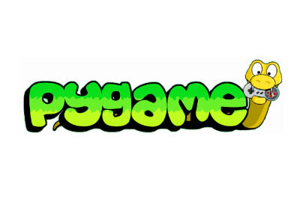
Show Time

Slide 17
References
[1] https://cloud.tencent.com/developer/article/1075527

Slide 18
Any questions?
Thanks for Watching!

